Slide 1

CSS Flexbox & Grid Layout

Slide 2
Introduction to Flexbox
One-dimensional layout system (row or column).
Helps align & distribute space among items.
Parent = flex container, Children = flex items.

Slide 3
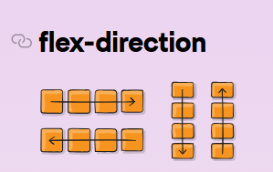
flex-direction
Defines the main axis.

Slide 4
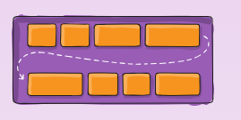
flex-wrap
Controls whether items wrap into new lines.

Slide 5
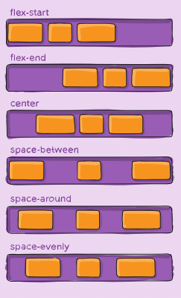
justify-content
Aligns items along main axis.

Slide 6
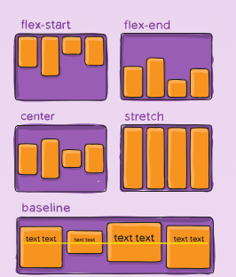
Align-items
Aligns items along cross axis.

Slide 7
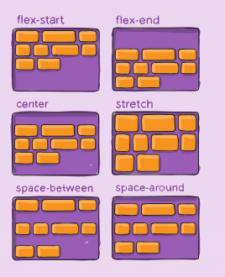
Align-content
Works when multiple lines of flex items exist.

Slide 8
Gap, flex grow, order
Adds spacing between flex items.
No need for margins. Flex-grow=> Controls how much item expands to fill space. Order=> Changes the visual order of flex items.

Slide 9
Grid Section
Two-dimensional layout system.
Works with rows + columns.
Parent = grid container, Children = grid items.

Slide 10
Grid-template-columns & rows
Defines columns & rows size. grid-template-columns: 100px 200px auto;
grid-template-rows: 100px auto;

Slide 11
grid-row / grid-column start & end
Place items across grid lines.

Slide 12
grid-template-areas
Create layout by naming grid areas. =>We can use justify-content in grid also;

